Slide 1

By Hiren Mistry
VTCBB

Slide 2

Wisdom
Connectedness
Understanding
Principles
Knowledge
Understanding
Patterns
Information
Understanding
Relations
Data
Understanding
Flow of Data To Qualified Wisdom
VTCBB

Slide 3
Data
  Row Details
  Simply Exists and has no significance
  Unarranged , unprocessed, may or may not have meanings
  Examples: facts, analysis, statistics in computer terms, symbols, characters, images or numerical data
Information
  Meaningful Data
  Useful
  Relational Data
  Example: List of Seven Wanders is Data but Book of Each Wander is Information
VTCBB

Slide 4
Knowledge
  appropriate collection of information
  someone "memorizes" information (as less-aspiring test-bound students often do), then they have total knowledge
  Needs true mental process of knowing (Understanding) and analytical ability
  Example:
  2 x 2 = 4 easy to memorize but when 1267 x 1233 = ? quite difficult to give answer and also difficult to memorize it.
VTCBB

Slide 5
Understanding
  An inserting and adding as well as probabilistic process
  Take knowledge and learn or join new knowledge from the previously held knowledge
  Difference between understanding and knowledge is the difference between "learning" and "memorizing”
  Example : AI systems
Wisdom
  An analytical and non-probabilistic process
  The process by which we recognize, or judge, between right and wrong, good and bad
  A uniquely human state
VTCBB

Slide 6

Relation between Data, information, knowledge and understanding
  Data : represents a fact or statement of event without relation to other things.
  Information : represents the understanding of a relationship of some sort, possibly cause and effect.
  Knowledge : represents a pattern that connects and generally provides a high level of predictability as to what is described or what will happen next with the help of understanding.
  Wisdom : represents more of an understanding of fundamental principles represented within the knowledge that are essentially the basis for the knowledge being what it is.
VTCBB

Slide 7
Benefits of Information
  The value of information is directly linked to how it helps decision makers achieve the organization’s goals discuss why it is important to study and understand information systems.
  Distinguish data from information and describe the characteristics used to evaluate the quality of Computers and information systems are constantly making it possible for organizations to improve the way they conduct business.
  Name the components of an information system and describe several system characteristics Knowing the potential impact of information systems and having the ability to put this knowledge to work can result in a successful personal career, organizations that reach their goals, and a society with a higher quality of life.
VTCBB

Slide 8
Cont..
  List the components of a computer-based information system.
  Identify the basic types of business information systems and discuss who uses them, how they are used, and what kinds of benefits they deliver.
  Identify the major steps of the systems development process and state the goal of each Information systems must be applied thoughtfully and carefully so that society, business, and industry can reap their enormous benefits.
  To discuss the expanding role and benefits of information systems in business and industry
VTCBB

Slide 9

Information System is not a single process or object
Made by four elements
  Input
    Activity of gathering row data
  Process
    Converting or transforming into useful data
    Can involve calculations, comparing data, taking alternative actions and storing for future use
    Manual of computer assisted.
VTCBB

Slide 10
Cont..
  Output
    Producing useful information
    Usually in the forms of documents and reports
  Feedback
    Information from the system that is used to make changes to input or processing activities.
    Example : Error Detection and Correction
    Important for managers and decision makers
    This concept often called forecasting
VTCBB

Slide 11
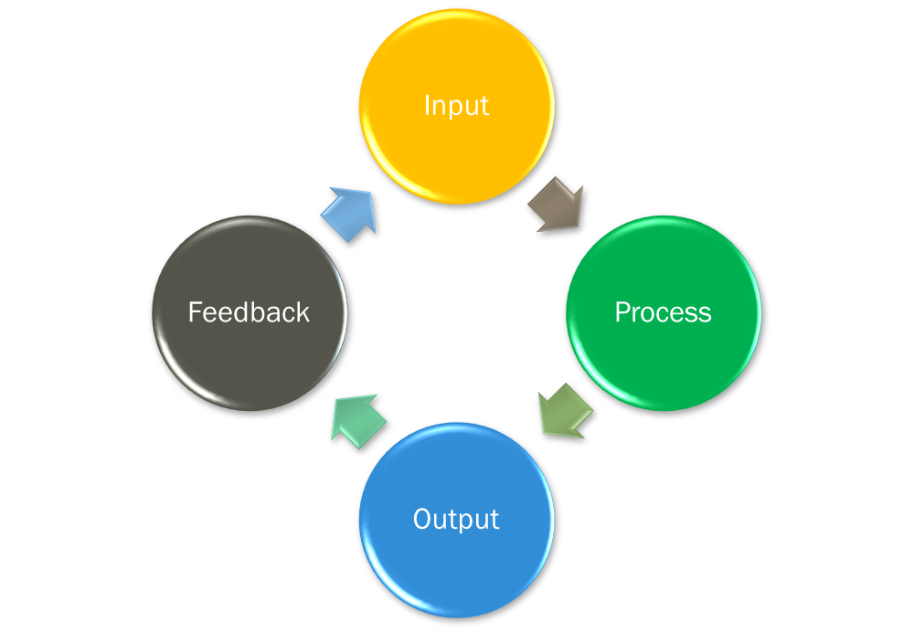
Information Cycle
VTCBB

Slide 12

Information System is a set of interrelated components work together to collect, retrieve, process, store and disseminate information for the purpose of facilitating planning , control , analysis ,coordination and decision making in business and other organizations .
Information System can be categorized in two system types
  Manual Information System
    Totally Human Managed
    With Simple tools
    With Books and Paper Stationary and pencils and pen,
VTCBB

Slide 13
Cont..
  Computer Based Information System
    Computers play major role
      Hardware :
        Refers machinery
        Support equipments are inputs and output devices ,storage devices and communication devices
      Software:
        Computer programs and software
      Data:
        Facts that are used by programs to produce useful information
      Procedures:
        Policies that governs the operation of a computer system
      People:
        Users uses the system
VTCBB

